Slide 2
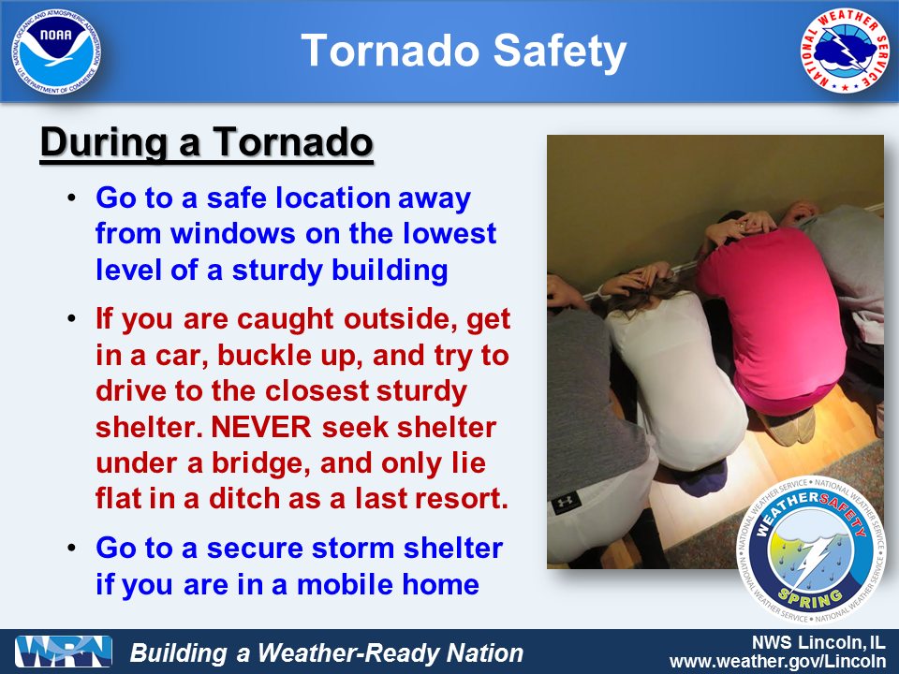
Tornadoes

Slide 3
Objectives
Lightning
Electric charge separation
Stroke development, types
Thunderstorms
Air mass and severe t-storms
Tornados
Fujita scale, geographic distribution
Supercell storms, tornado genesis
Last Thursday, Today

Slide 4
Thunderstorms: Air Mass, Multicell, and Supercell
Multicell and Supercell Storms
Supercells are more severe and intensely powerful storms that contain a single updraft zone.
Severe thunderstorms have wind speeds that exceed 93km/hr (58mph), hailstones larger than 2.4cm (1in) in diameter, or spawn tornadoes.
Wind shear, high water vapor, uplift, and instability are critical conditions for severe storm development.
A single, extremely powerful single cell thunderstorm.
Complex array of up and downdraft relationship.
Potential for tornados, supercell features are a “hook”

Slide 5
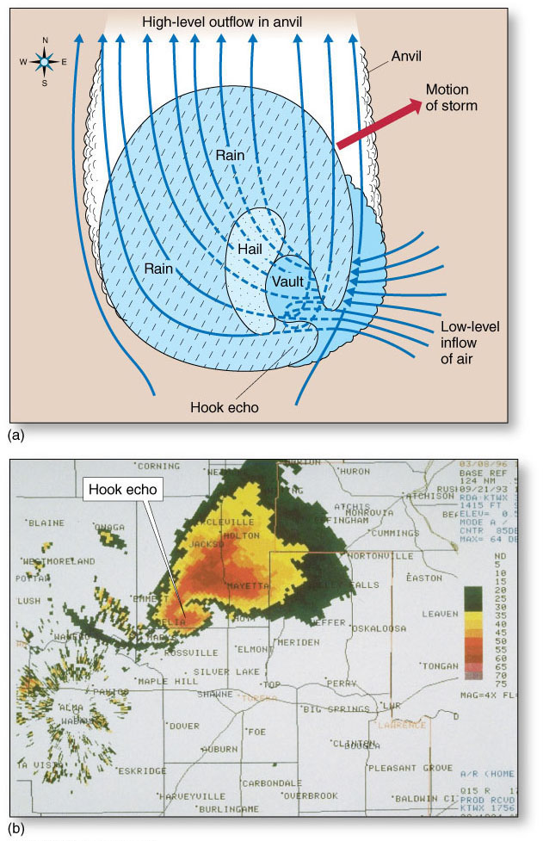
Thunderstorms: Air Mass, Multicell, and Supercell
“Hook echo”: tornado possible/likely.

Slide 6
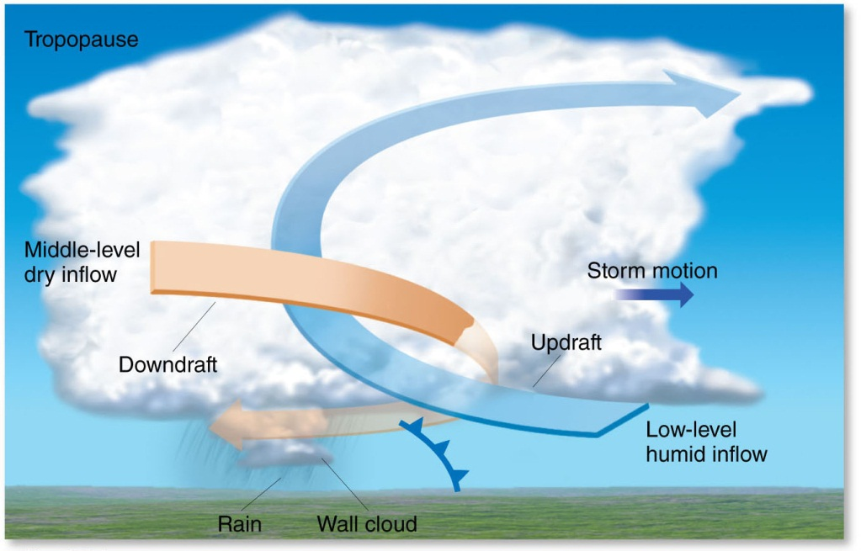
Thunderstorms: Air Mass, Multicell, and Supercell
Multicell and Supercell Storms

Slide 7
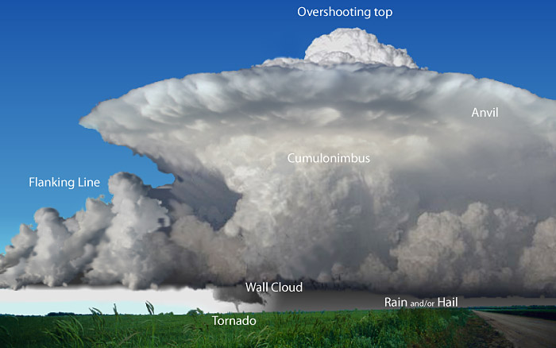
Thunderstorms: Air Mass, Multicell, and Supercell
Multicell and Supercell Storms

Slide 8
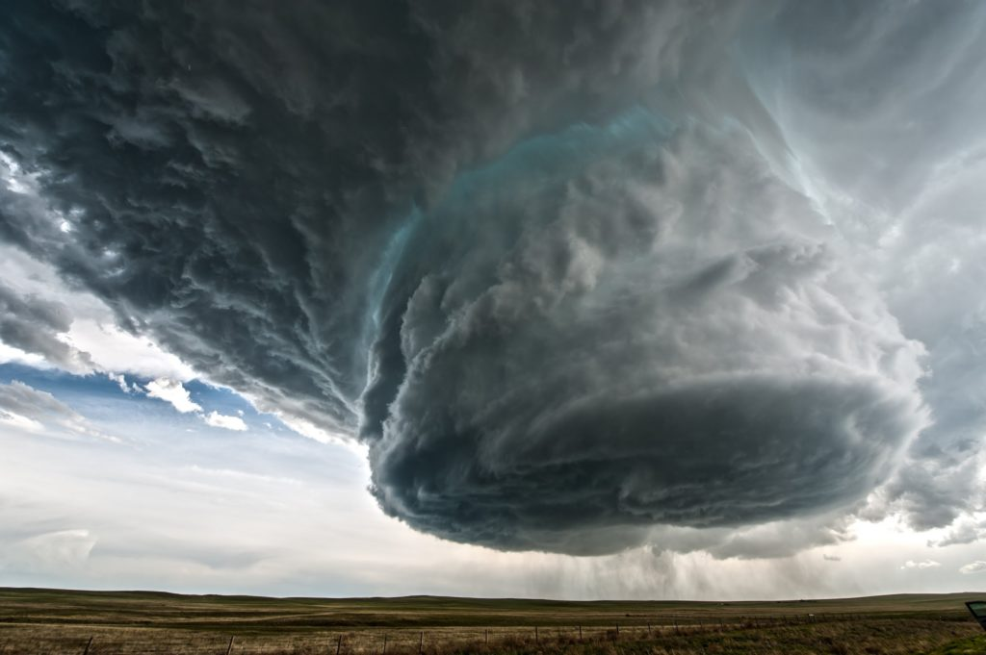
Thunderstorms: Air Mass, Multicell, and Supercell
Wall cloud

Slide 9
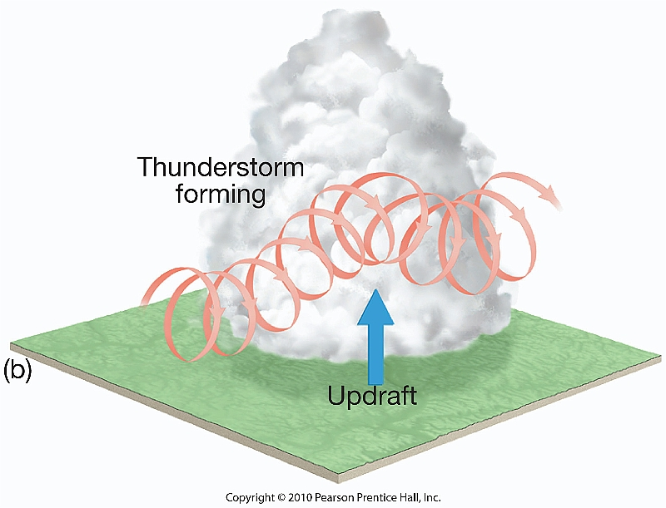
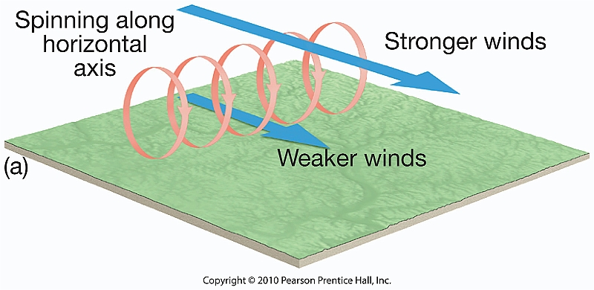
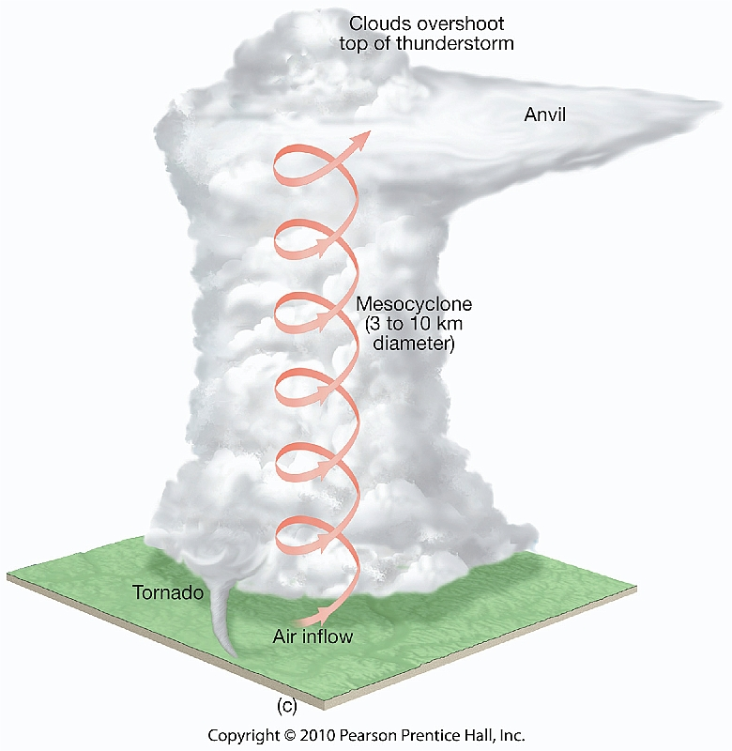
Tornadoes
Supercell Tornado Development (about ½ of all tornados)
1. Mesocyclone development
Vorticity generated! = conserved
Updrafts also stretch the vorticity (still constant),
Can only be done if it rotates faster!
Strong wind shears cause horizontal rotation (roll cloud) within cloud.
Strong updrafts push rotation into the vertical -> vortex develops (counter-clockwise = low pressure at ground) – called mesocyclone development.

Slide 10
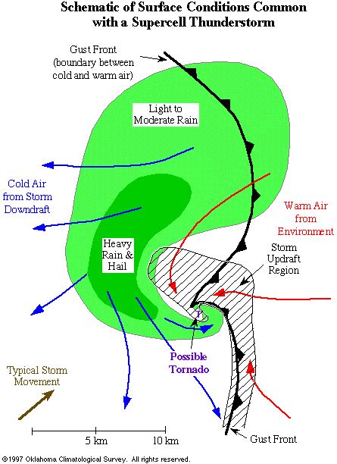
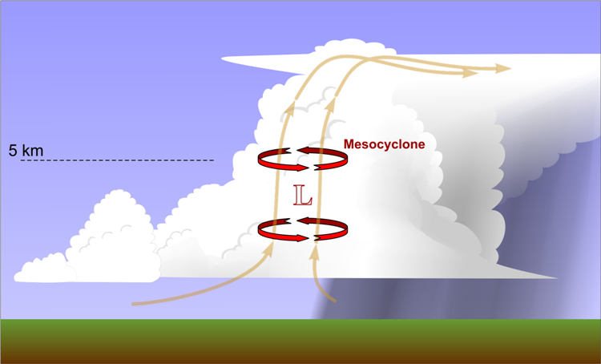
Tornadoes
Supercell Tornado Development (about ½ of all tornados)
2. Wall cloud development
Mesocyclone provides initial rotation but is not yet a tornado (and most never will be).
Mesocyclone produces low pressure at the ground -> additional uplift
Draws in cool but moist air from nearby precipitation area.
Uplifted cool & moist air causes condensation at lower altitude –> wall cloud.
Also draws in warm & moist air from non-precipitating areas.
Wall clouds do not precipitate.

Slide 11
Tornadoes
Supercell Tornado Development (about ½ of all tornados)
3. Tornado development - tornadogenesis
Dynamic Pipe Effect
(late 1970’s)
If low pressure at ground underneath the mesocyclone is low enough,
the rotation can reach the ground, friction causes the radius of the vortex to narrow -> rapidly intensifying the wind speeds (vorticity is still conserved) -> tornado

Slide 12
Tornadoes
Supercell Tornado Development (about ½ of all tornados)
3. Tornado development - tornadogenesis
Bottom-up effect
(1980’s)
Many tornados where observed that have insufficient rotation to generate the very low pressure at the surface required by the Dynamic Pipe Effect.
Second mechanism: Additional vorticity generation through down/updrafts along the gust front; adds to mesocyclone vorticity.

Slide 13
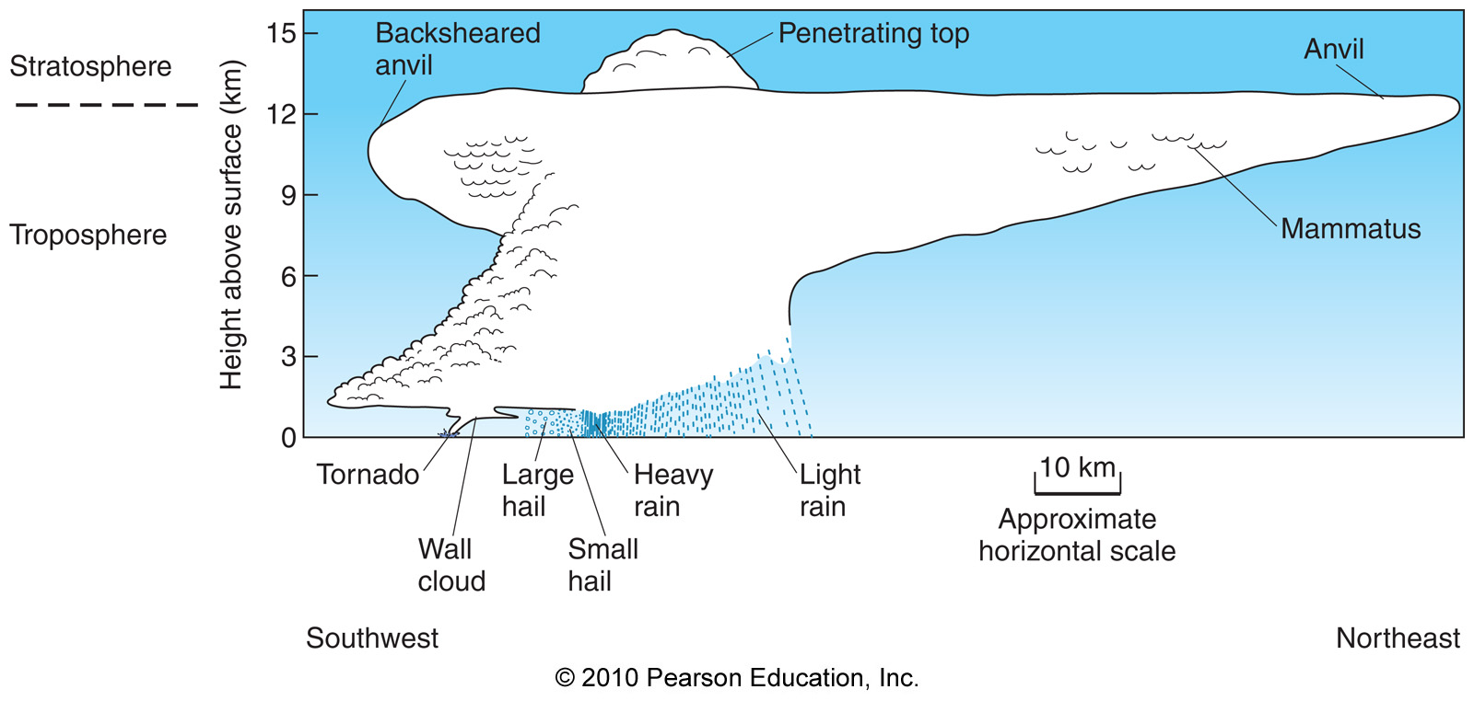
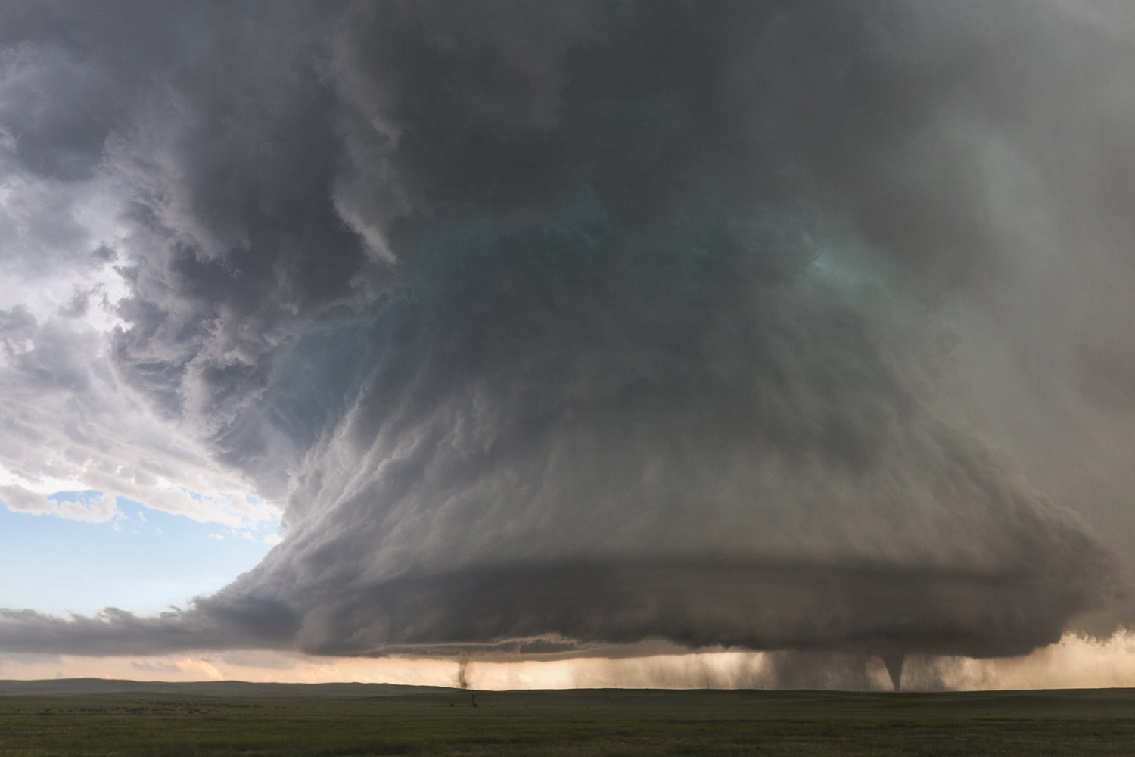
Tornadoes

Slide 14
Tornadoes
Tornadoes are zones of extremely rapid, rotating winds beneath the base of cumulonimbus clouds.
Tornadoes occur in a wide variety of shapes and sizes.
They usually only last a few minutes and travel northeast at comparable speeds of a car.
The weakest tornadoes have wind speeds as slow as 105km/hr (65mph).
The strongest tornadoes have wind speeds as fast as 450km/hr (280mph).

Slide 15
Tornadoes
Non-supercell tornados
Tornadoes also develop in frontal boundaries, squall lines, MCCs, and tropical cyclones.
The process leading to their (and supercell tornado) formation is not well understood.

Slide 16
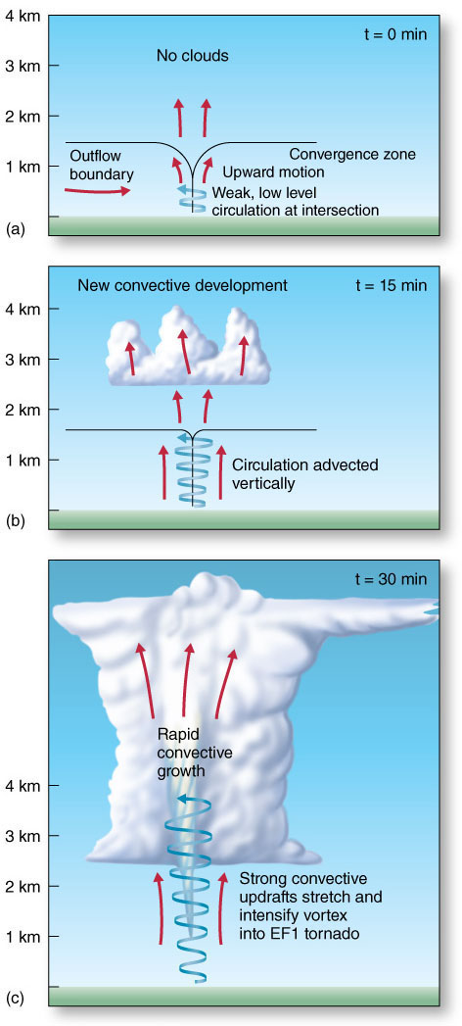
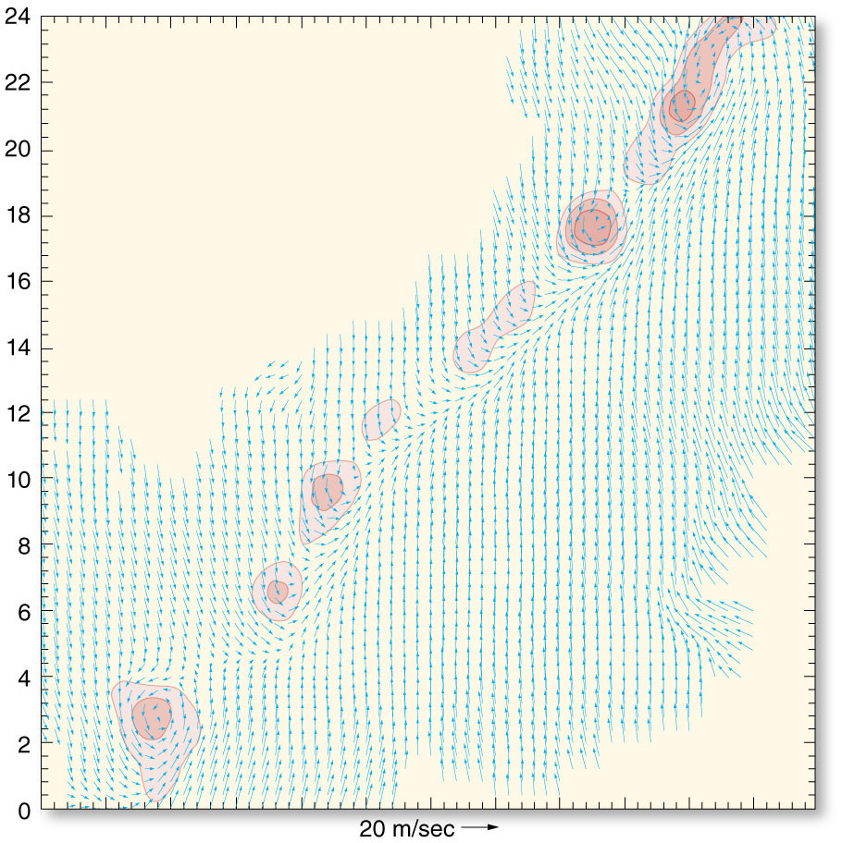
Tornadoes
Tornado Formation
Nonsupercell Tornado Development
Outflow from separate storm downdrafts convergence. Usually weaker tornados.

Slide 17
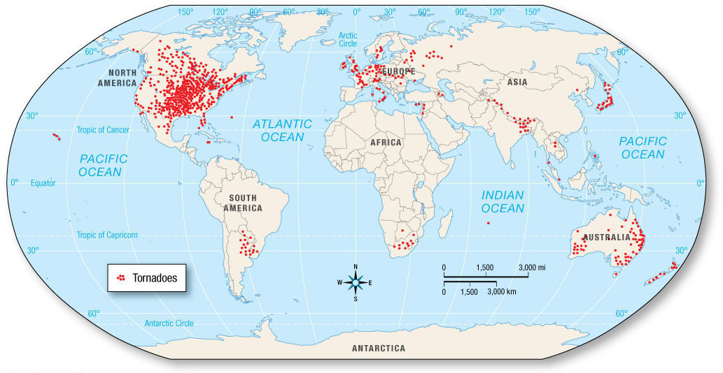
Tornadoes
Tornado Formation
Tornadoes around the globe.

Slide 18
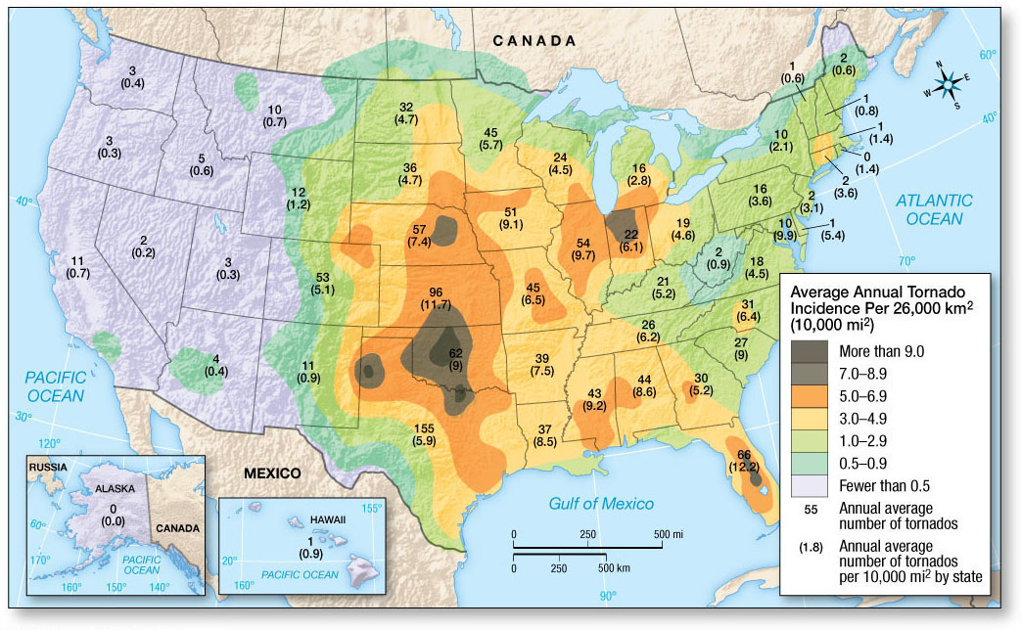
Tornadoes
The Location and Timing of Tornadoes, tornado alley

Slide 19
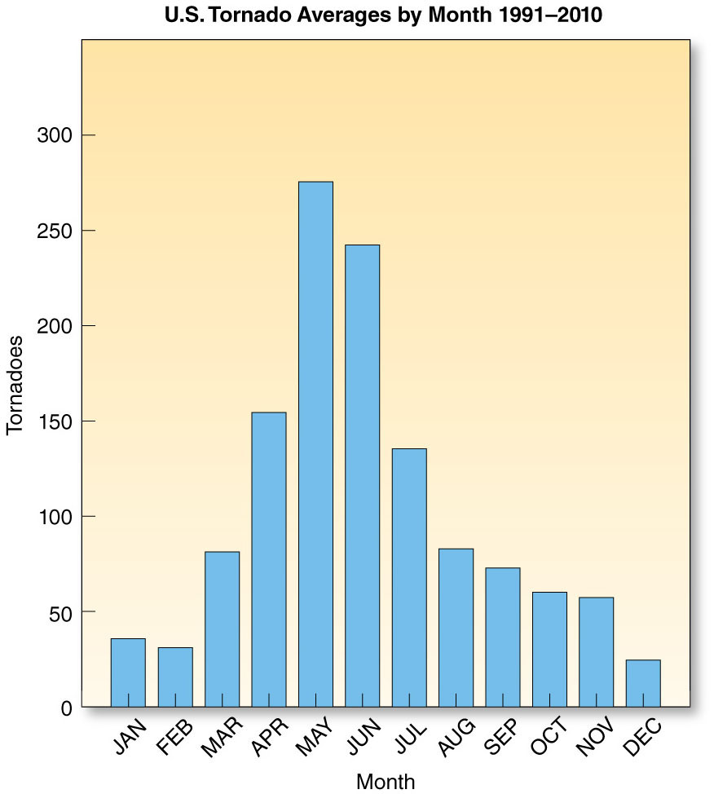
Tornadoes
The Location and Timing of Tornadoes
Most tornadoes occur in the springtime, when the contrast between warm and cold air in the atmosphere is the greatest.

Slide 20
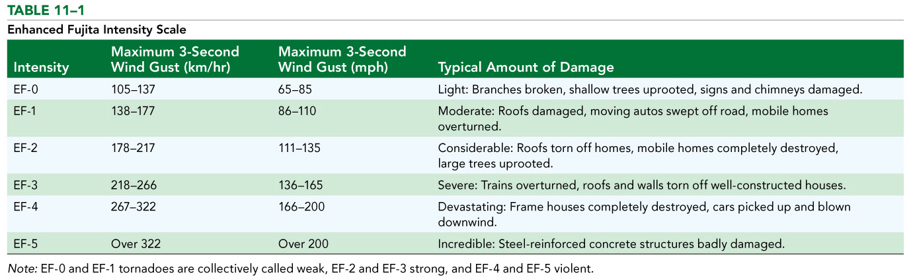
Tornado Hazards and Forecasting
Tornado Damage
Tornadoes are classified by the magnitude of damage they cause using the (enhanced) Fujita scale.

Slide 21
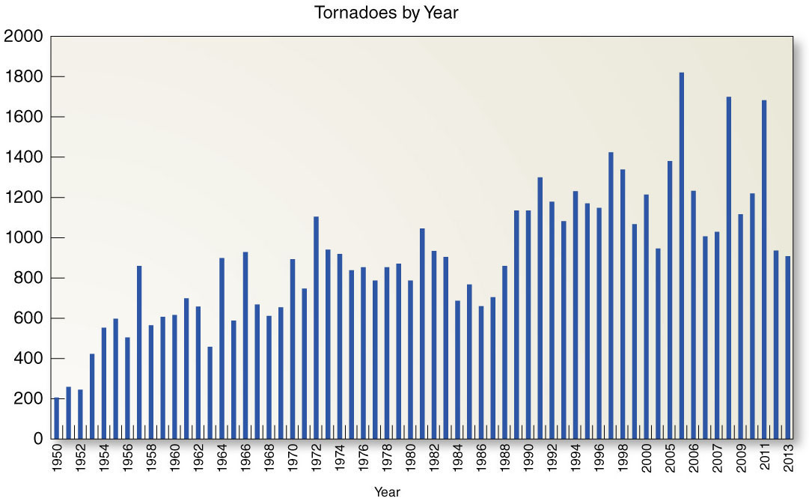
Tornado Hazards and Forecasting
Trends in U.S. Tornado Occurrence
As population centers have expanded into formerly rural areas, there is a greater probability that a tornado would hit a structure or be observed.

Slide 22
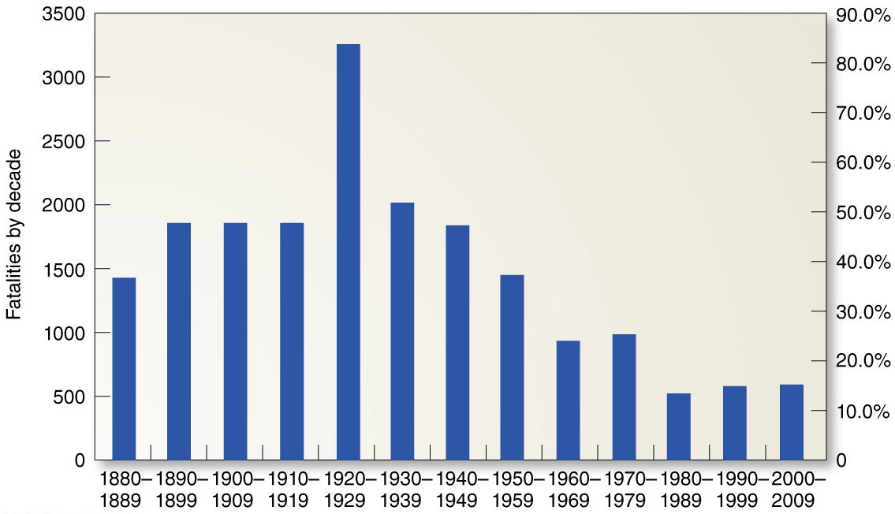
Tornado Hazards and Forecasting
Fatalities
Fortunately, most tornadoes kill no one. Some, unfortunately, are deadly.

Slide 23
Tornado Hazards and Forecasting
Tornado Outbreaks
Tornado outbreaks
Tornado outbreaks describe an event in which a single weather system produces at least six tornadoes.

Slide 24
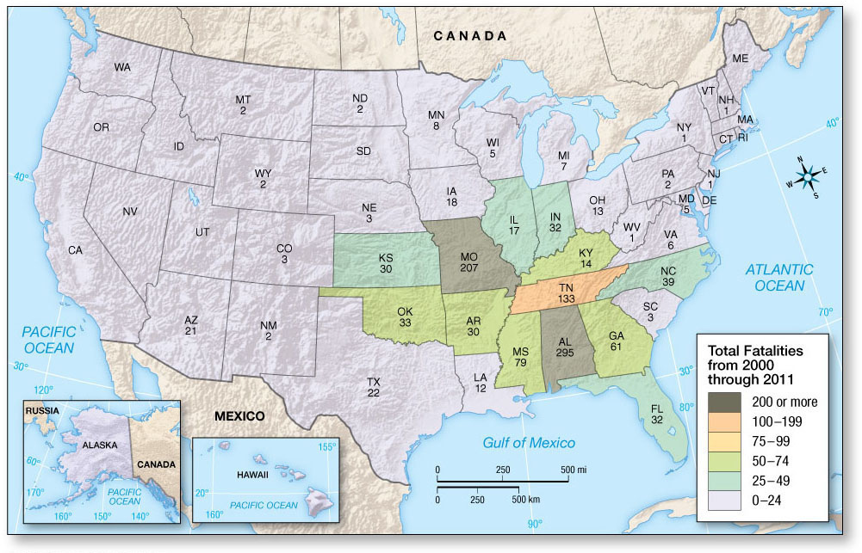
Tornado Hazards and Forecasting
Fatalities
Tornado fatalities by state.

Slide 25
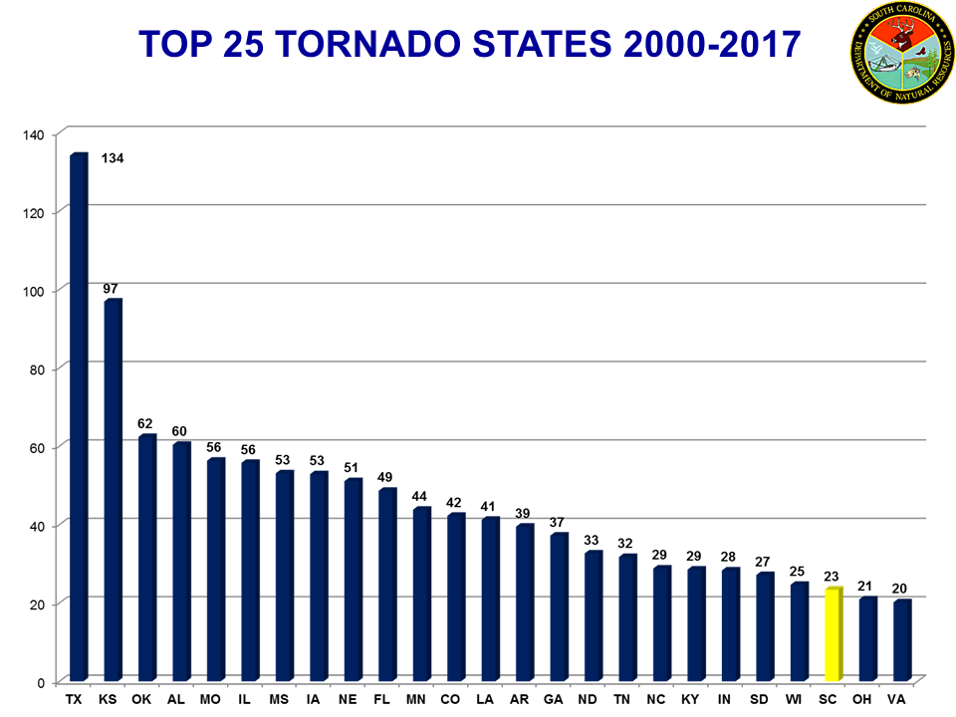
Tornadoes

Slide 26
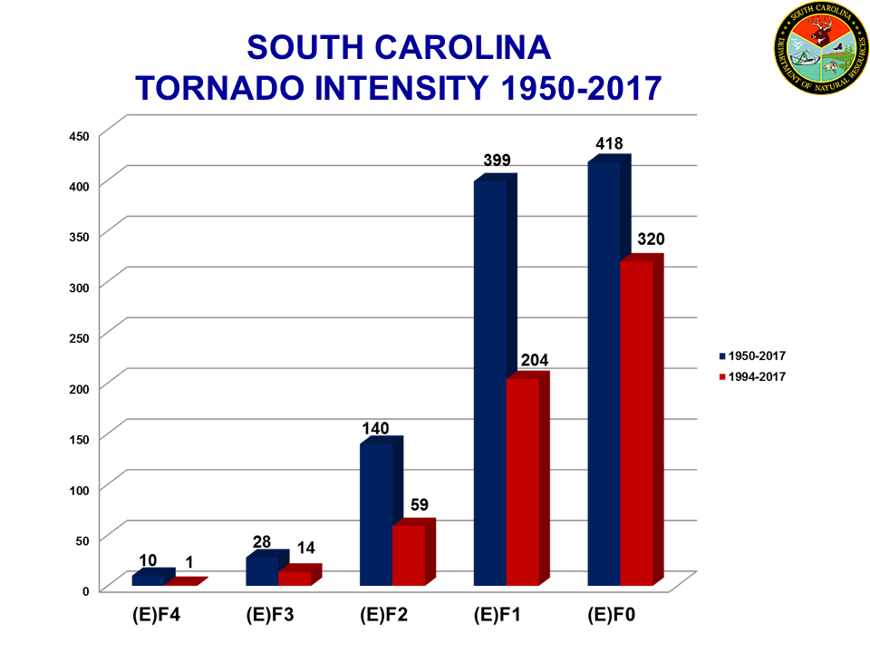
Tornadoes

Slide 27
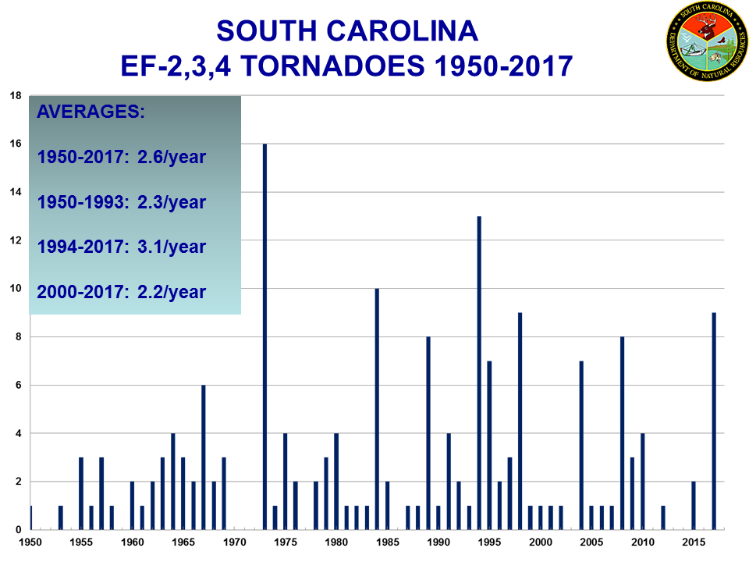
Tornadoes

Slide 28
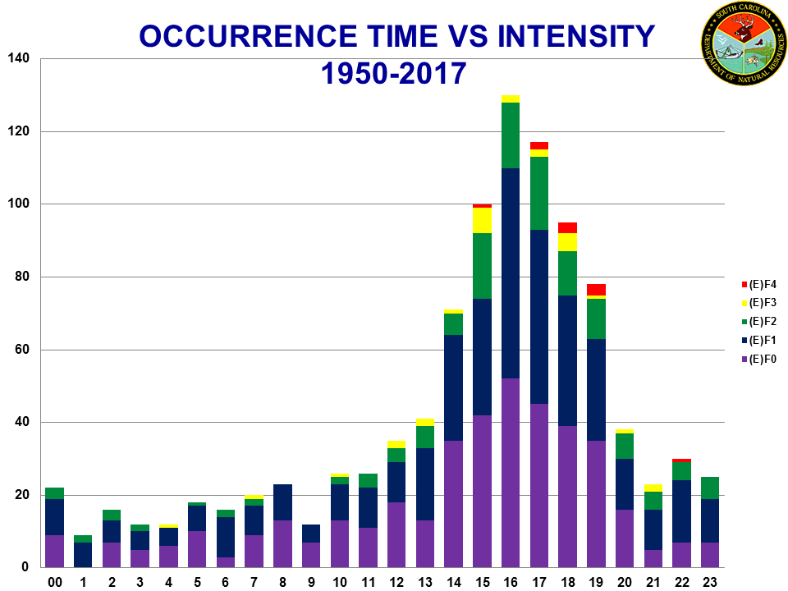
Tornadoes

Slide 29
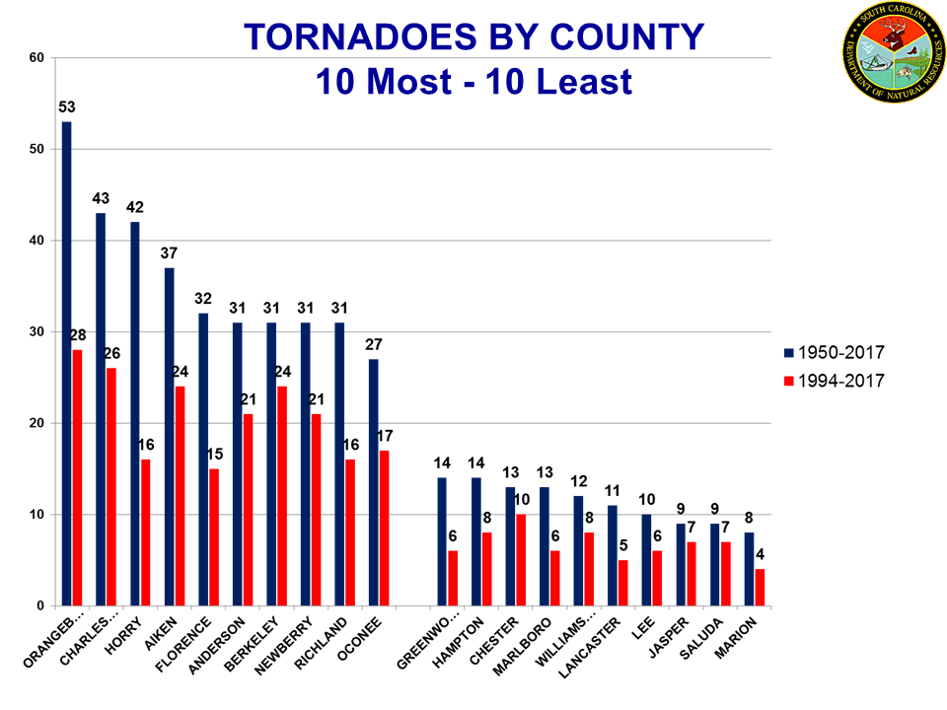
Tornadoes

Slide 30
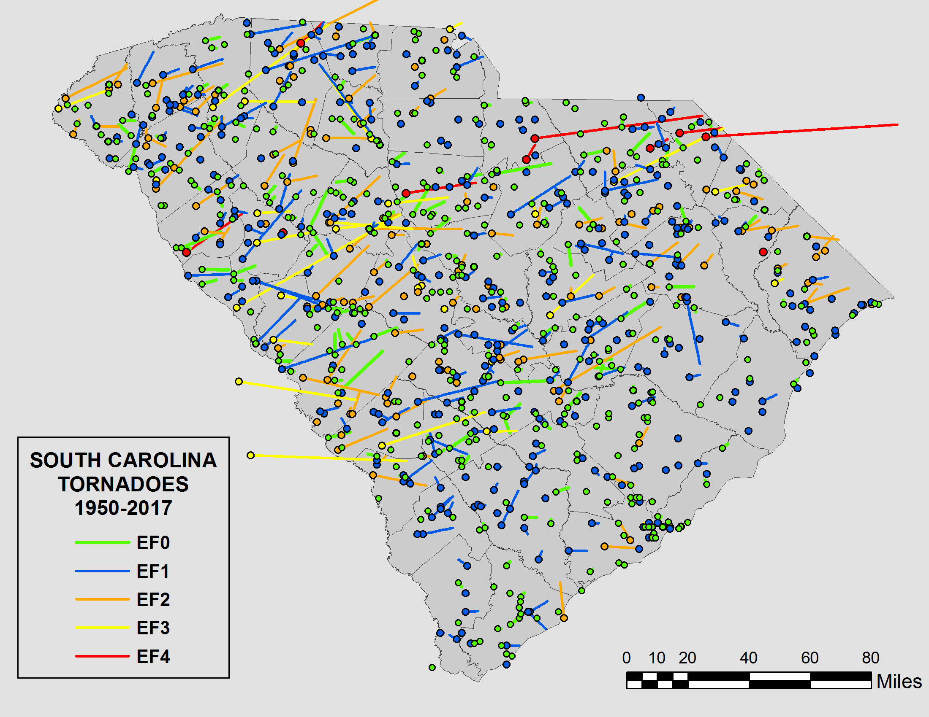
Tornadoes

Slide 31
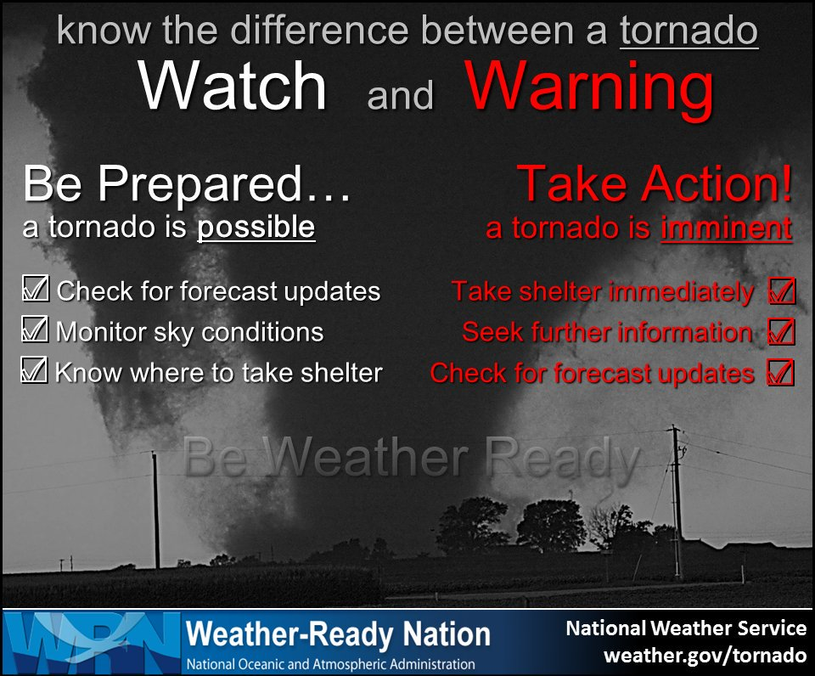
Tornado Hazards and Forecasting

Slide 32
Tornadoes

Slide 33
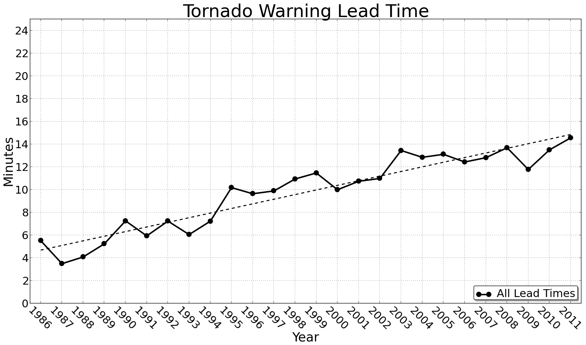
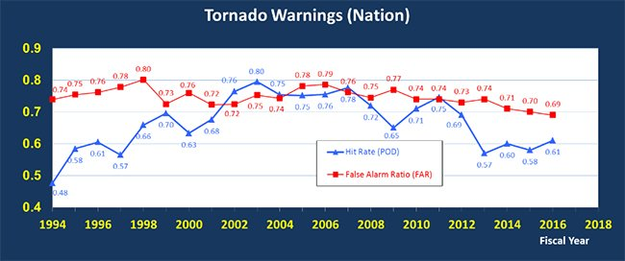
Tornado Hazards and Forecasting
Warning lead times today ~15 min
BUT: People need to hear it - a major problem and cause for many fatalities
Cell phones, weather radio
Blue: rate of how many tornados happened when a warning was issued
Red: false alarm rate (high)
Still a lot of work to do!

Slide 34
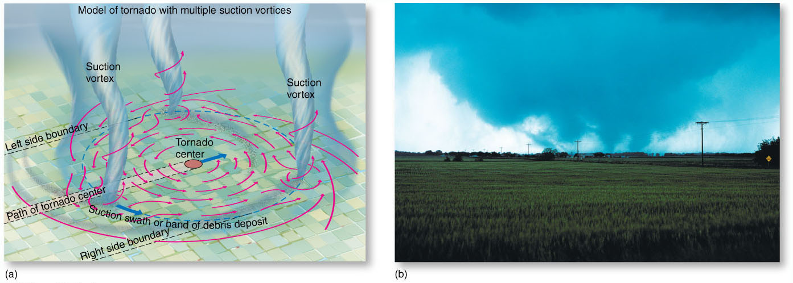
Tornado Hazards and Forecasting
Tornado Damage
Most tornadoes rotate around a single core, some of the most violent ones have several small zones of intense rotations called suction vortices.

Slide 35
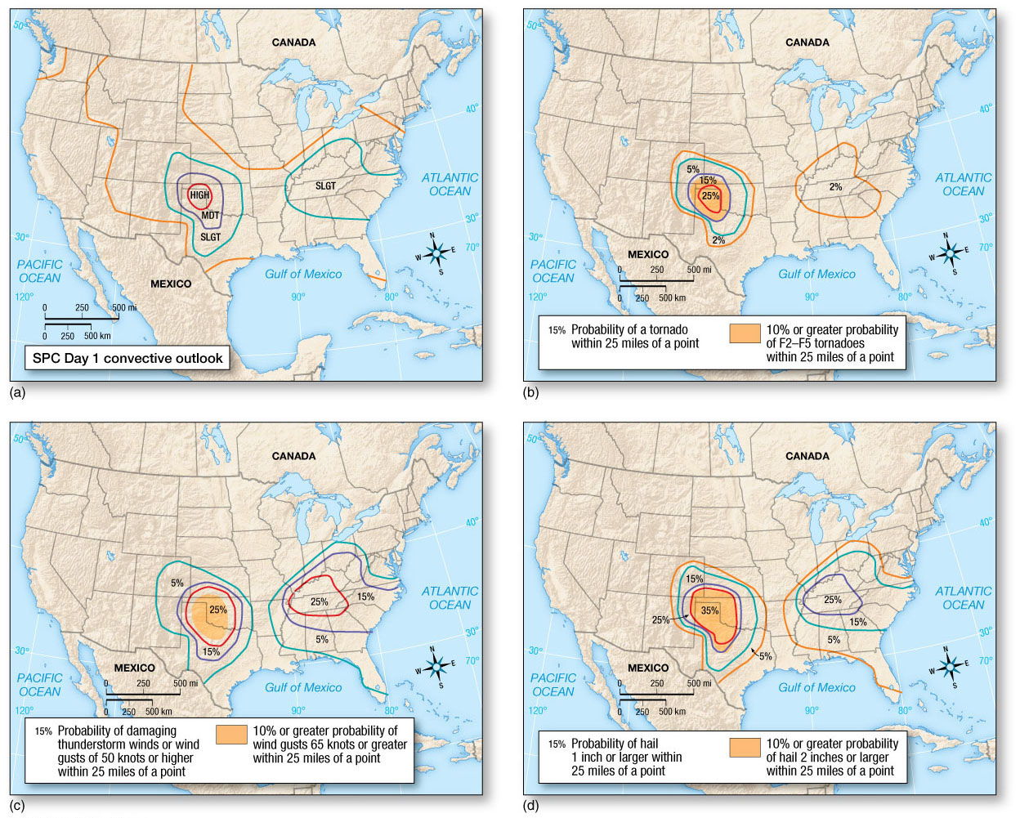
Tornado Hazards and Forecasting
Tornado Forecasting: Convective Outlooks

Slide 36
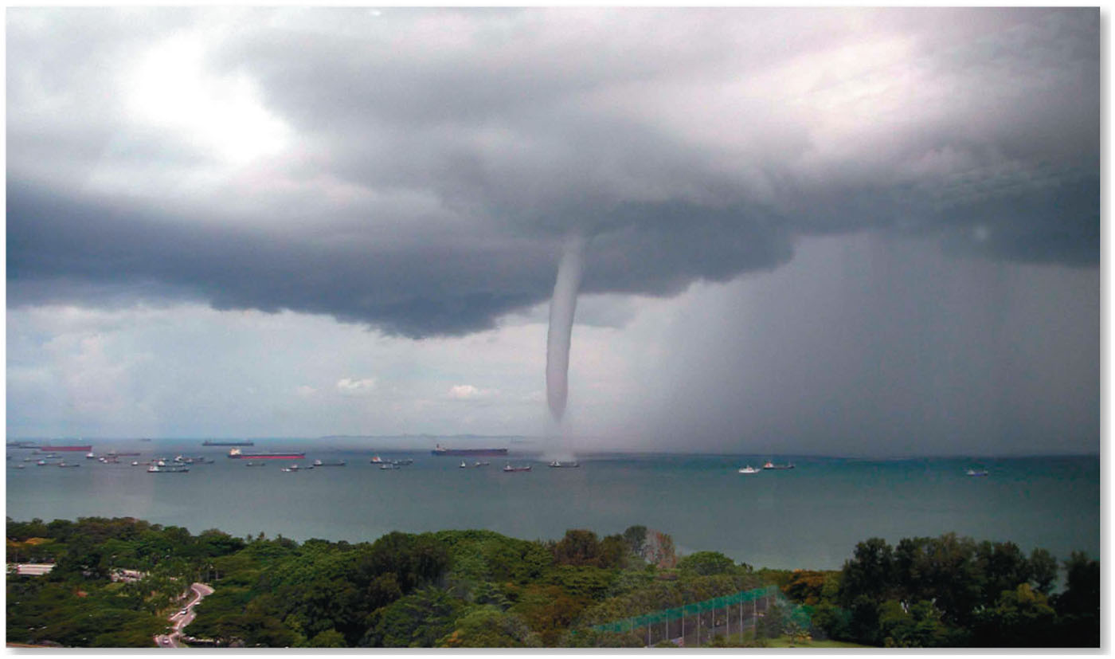
Waterspouts
Waterspouts are tornadoes that occur over warm-water bodies, instead of over land.

Slide 37
Attendance Quiz
Please go to Canvas and do the attendance quiz!
Needs to be completed between 9 am and 5 pm on April 21. Usual 3 min time limit.
Password: tornado

Slide 38
Summary and Outcomes
Lightning (the principles)
Electric charge separation
Stroke development, types
Thunderstorms
Air mass and severe t-storms, multicell, squall lines – pushed by cold fronts in self-sustained way
Tornados
Fujita scale, geographic distribution
Supercell storms, tornado genesis – uplift of roll cloud, vorticity
Tornados move in most cases towards the NE.
If your LAST RESORT is to drive – right angle to storm track.
Tornado safety!!!! Take warnings seriously and act!!!
Thursday: hurricanes

